Slide 1
Image Viewer Java Programing
By
Krzysztof Dziurawiec
HNC student

Slide 2
Main features of Java
Simple
Java is Easy to write and more readable and eye catching
Object oriented
Java is a pure Object oriented. Every thing in java is object. All programs and data reside inside objects and classes
Distributed
Java has networking facilities, so java can create application on network.
Robust
Java encourages error-free programming by being strictly typed and performing run-time checks.

Slide 3
Platform independent
Java compiler generates an platform independent code called byte code.
Java combines both compiler and interpreted
Use of byte code makes the performance high
Multithreading which means handling more than
one job at a time.
Java is a dynamic language. So it is capable of
linking dynamic new classes, methods and objects
Secure
A security code is asked before a java code is interpreted on internet.

Slide 4
Environmental flexibility of Java
Programing in Java is flexible because:
Creating objects makes java modular which means that program can be divided into smaller independent parts which are called when needed.
Libraries of classes can be imported when needed.
Java programs can execute in any environment for which there is a Java run-time system which makes it platform independent.
Java supports cross-platform code through the use of Java byte code.
Multithreading feature makes it possible to write program that can do many tasks simultaneously
Java is a distributed language which means that the program can be design to run on computer networks

Slide 5
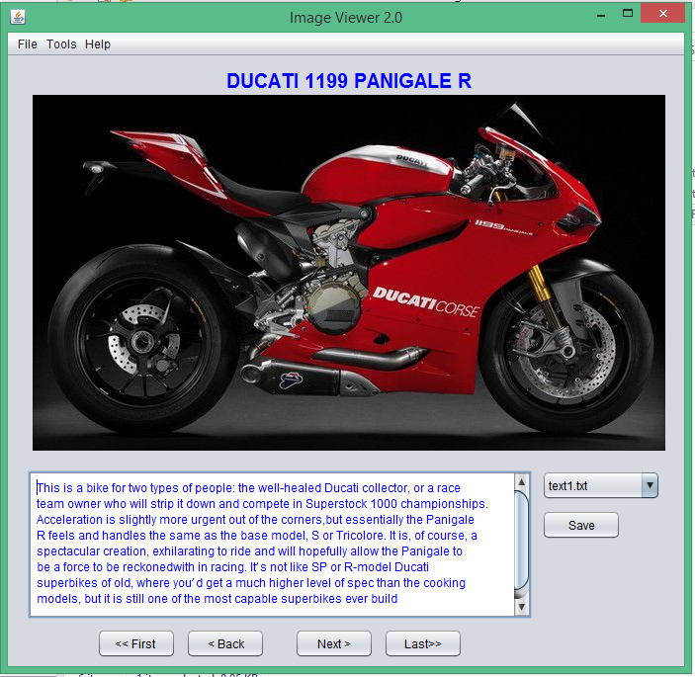
Image Viewer interface

Slide 6
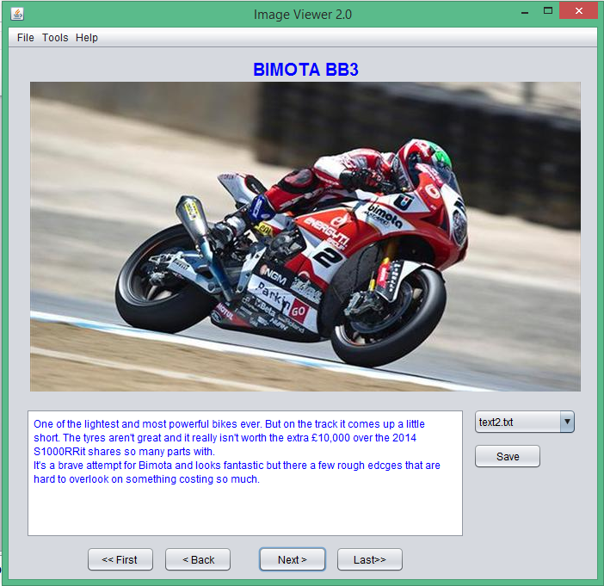

Slide 7
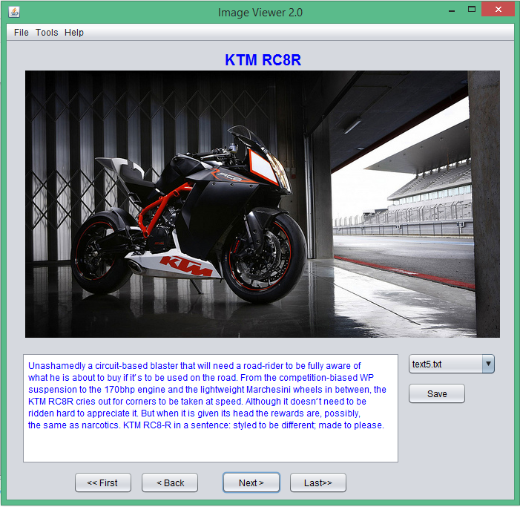

Slide 8
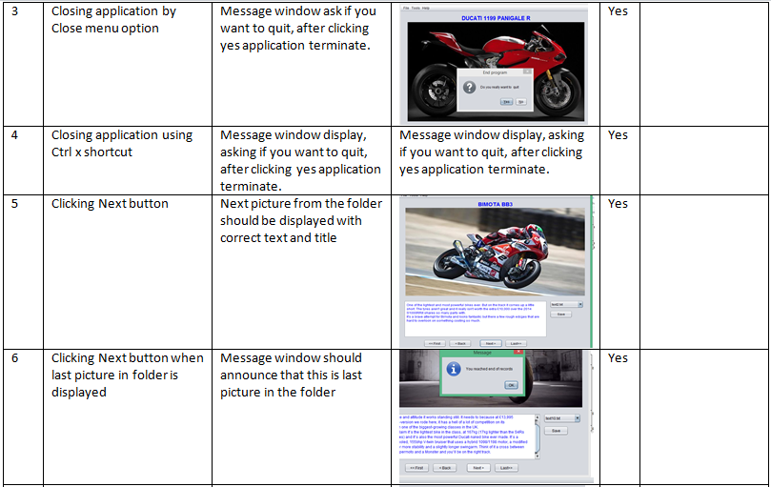
Tests screen shots

Slide 9
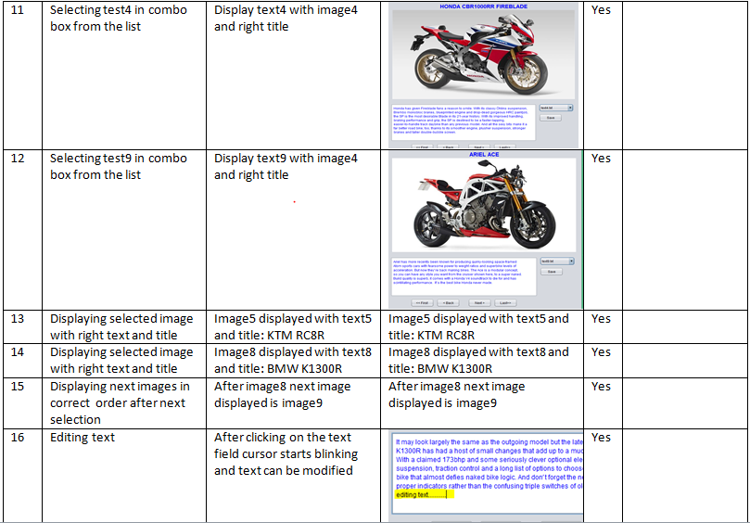

Slide 10
Help
1. Overview
Image Viewer is a java application which displays images and related text. Images and text files are stored in Images and Text folders. User can select required image by clicking on navigation buttons below text field or select directly from combo box.
Additionally application has option to edit and save text from text area; open image in Paint for editing purpose.
2. Version
Image Viewer version 2.0 java application created in June 2015 by Krzysztof Dziurawiec HNC student at Newbury College.
3. Installing application
To successfully install Image Viewer please copy Image Viewer Folder into chosen directory. Image Viewer Folder should contain: images Folder, text Folder, run.exe file, readme.txt file, about.txt file and Documentation folder.
4. Opening application
To open Image Viewer application please goes to Image Viewer Folder. Inside the folder find file: run.jar and double click on it after which application will launch.
To run Image Viewer on your system, you need to have installed Java Run Environment version 8.
To open Image Viewer in command prompt go to Image Viewer location by using command cd (full path) and enter "java -jar run.jar" which opens application

Slide 11
5. Main Functions
5.1. Navigation buttons
• Next button – after clicking this button next image with related text will be displayed
• Back button – after clicking this button previous image with related text will be displayed
• First button – clicking this button will display the first in the folder image with related text.
• Last button - clicking this button will display the last in the folder image with related text.
5.2. Using combo box
By clicking on one of the title inside the combo box, user is selecting image and text for display.
5.3.Editing text
To edit text please click inside text area. After clicking, cursor should appear and you can make changes to the text.
5.4. How to save edited text
To save edited text please click on Save button next to text area or select Save option from File menu in Menu bar. After clicking, program default directory will open. Please choose which file you making changes to and click save. Please note that title in combo box displays the name of the file which you are currently editing, so if you want save changes to the same file, please choose text file with the same name as shown in combo box.
5.5. How to open image in Paint
To open selected image in Paint, please go to Menu bar, File menu and choose Open in Paint option. Current image will open in Paint application ready to edit.
5.6. Changing font colour
To change font colour of text, go to Menu bar, Tools menu and choose Font Colour option. New window will open in which you can set new colour and click Apply button to implement changes.
5.7.Look and Feel option
You can change the look of application. There are two available themes: Nimbus and Metal. To change current theme, please go to Menu bar, Tools menu, Look and Feel sub menu and click on theme of your choice.
5.8. Help menu
For help related to application interface or functionality go to Menu bar, Help menu and choose About option, which will open about.txt file.
6. Closing application
To close, please select in Menu bar, File menu and click on Close option or alternatively press Ctrl + x shortcut combination. In next window you will be asked if you really want to quit, pressing Yes would close application.

Slide 12
System evaluation
All menu options are working properly and correct functions are open after clicking selected option. All buttons are working properly and assigned functionality is working correctly. External program Paint and Notepad are opening as an option from main program.
Having options to change application look theme and font colour it provide option to personalize application accordingly to the user taste and make it more personal. Unfortunately the settings selected by user are lost after application is closed, so I would suggest as an future improvement to save changed settings by overriding current default settings which allows to reopen application with user preferred theme.
Handling exceptions are working accurate, by informing user about reaching beginning or end of the folder. “Try catch” exceptions implemented in the code are working correctly while opening text files or image files.

Slide 13
Current version of application is very rigid, it is possible to scale program by adding new images and texts but currently it is not user friendly. As an improvement, I would suggest creating a separate option for adding new images and text to the current Array List which would be more user friendly then current option which need adjusting the For loop counter “i” to the new number of files.
In conclusion, all tested features included in Image Viewer application are working correctly. Data is stored accurately in designed files: text(x).txt and images(x).jpg. Program is reading data from the file accurately and displays it in structured GUI environment. All elements are displayed in right place and correct order.

